Slide 1
HNDIT 2312-Principles of Software Engineering
Week 11: Software Maintenance

Slide 2
Topics Covered
Introduction to Software maintenance
Factors for maintenance
Types of maintenance
Cost of maintenance
Re-engineering

Slide 3
Software Maintenance
Software maintenance is widely accepted part of SDLC now a days. It stands for all the modifications and updates done after the delivery of software product.

Slide 4
Reasons for maintenance
Market Conditions
Policies, which changes over the time, such as taxation
Client Requirements
Over the time, customer may ask for new features or functions in the software.
Host Modifications
If any of the hardware and/or platform (such as operating system) of the target host changes
Organization Changes
any business level change at client end

Slide 5
Types of maintenance
Corrective Maintenance
Adaptive Maintenance
Perfective Maintenance
Preventive Maintenance

Slide 6
Corrective maintenance
This includes modifications and updates done in order to correct or fix problems, which are either discovered by user or concluded by user error reports.

Slide 7
Adaptive Maintenance
This includes modifications and updates applied to keep the software product up-to date and tuned to the ever changing world of technology and business environment.

Slide 8
Perfective Maintenance
This includes modifications and updates done in order to keep the software usable over long period of time.
It includes new features, new user requirements for refining the software and improve its reliability and performance.

Slide 9
Preventive Maintenance
This includes modifications and updates to prevent future problems of the software.
It aims to attend problems, which are not significant at this moment but may cause serious issues in future.

Slide 10
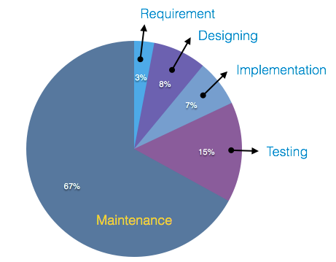
Cost of Maintenance

Slide 11
Maintenance Activities
IEEE provides a framework for sequential maintenance process activities.
It can be used in iterative manner and can be extended so that customized items and processes can be included.

Slide 12
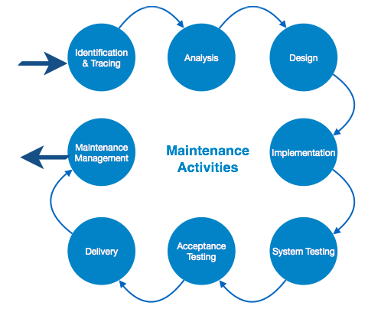
Maintenance Activities

Slide 13
Reverse Engineering
It is a process to achieve system specification by thoroughly analyzing, understanding the existing system.
Designers then do reverse engineering by looking at the code and try to get the design.

Slide 14
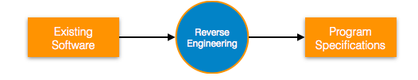
Reverse engineering

Slide 15
Forward Engineering
Forward engineering is a process of obtaining desired software from the specifications in hand which were brought down by means of reverse engineering.

Slide 16
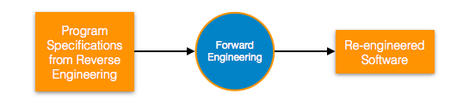
Forward Engineering

Slide 17
Software Re-engineering
When we need to update the software to keep it to the current market, without impacting its functionality, it is called software re-engineering.
Legacy software cannot keep tuning with the latest technology available in the market. As the hardware become obsolete, updating of software becomes a headache.

Slide 18
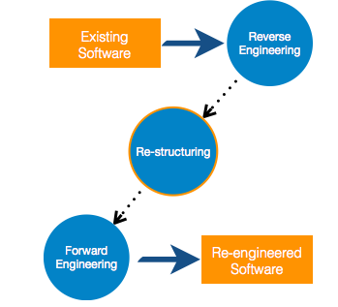
Re-Engineering Process

Slide 19
Program Restructuring
It is a process to re-structure and re-construct the existing software.
It is all about re-arranging the source code, either in same programming language or from one programming language to a different one.
Re-structuring does not impact the functionality of the software but enhance reliability and maintainability.

Slide 20
Maintenance management
Configuration management is an essential part of system maintenance.
It is aided with version control tools to control versions, semi-version or patch management.

Slide 21
Key points
A study on estimating software maintenance found that the cost of maintenance is as high as 67% of the cost of entire software process cycle.

